Slide 1
The Energy Frontier: Tevatron⇒LHC ⇒ ??
Eric Prebys
Fermilab
Director, US LHC Accelerator Research Program

Slide 2

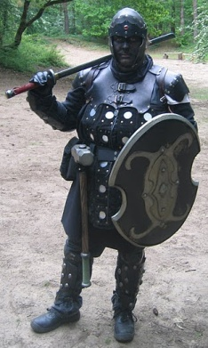
A Word about LARP
The US LHC Accelerator Research Program (LARP) coordinates US R&D related to the LHC accelerator and injector chain at Fermilab, Brookhaven, SLAC, and Berkeley (with a little at J-Lab and UT Austin)
LARP has contributed to the initial operation of the LHC, but much of the program is focused on future upgrades.
The program is currently funded at a level of about $12-13M/year, divided among:
Accelerator research
Magnet research
Programmatic activities, including support for personnel at CERN
Ask me about the Toohig postdoctoral fellowship!
(I’m not going to say much specifically about LARP in this talk)
NOT to be confused with this “LARP” (Live-Action Role Play), which has led to some interesting emails
“Dark Raven”

Slide 3
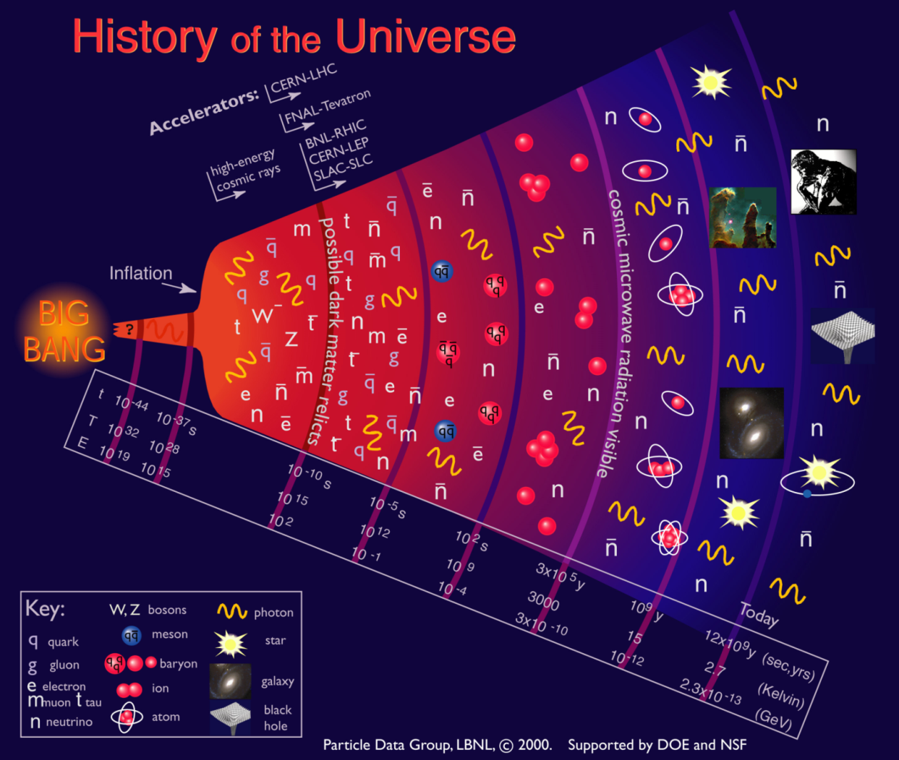
A Statement of the Problem
Accelerators allow us to recreate conditions that existed a few picoseconds after the Big Bang
It’s all about energy and collision rate (luminosity)

Slide 4
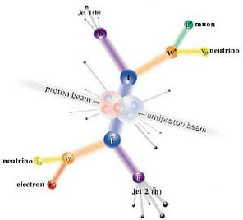
Major Choices
e+e- vs. pp (or p-pBar)
Electrons are simple and point like, but synchrotron radiation limits the energy of circular accelerators to ~100 GeV (LEP II)
Protons (and antiprotons) do not suffer this limitation, so they allow us to probe higher energy scales, in spite of the fact that only a fraction of the beam energy is available to the reaction
Fixed Target vs. Collider
Fixed target provides higher collision rate, BUT
Energy available in the CM grows very slowly
A fixed target machine with the CM energy of the LHC would be 10 times the diameter of the earth!!!

Slide 5
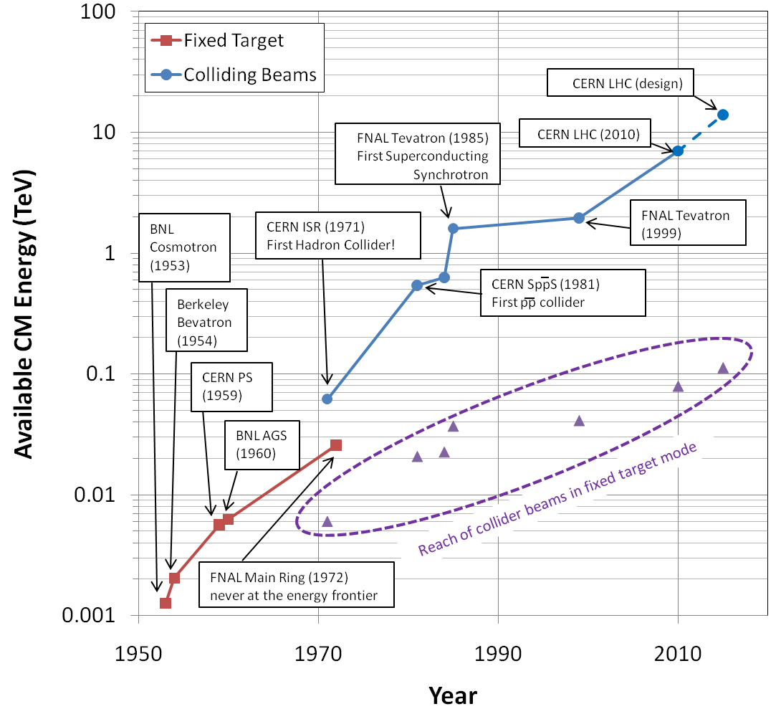
Evolution of the Energy Frontier
~a factor of 10 every 15 years

Slide 6
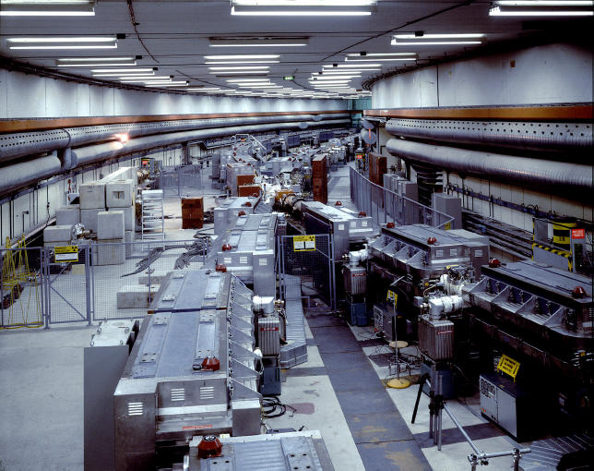
CERN ISR: Pioneering Machine
First hadron collider (p-p)
Highest CM Energy for 10 years
Until SppS
Reached it’s design luminosity within the first year.
Increased it by a factor of 28 over the next 10 years
Its peak luminosity in 1982 was 140x10³⁰ cm⁻²s⁻¹
a record that was not broken for 23 years!!

Slide 7
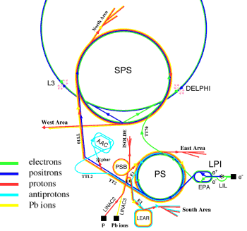
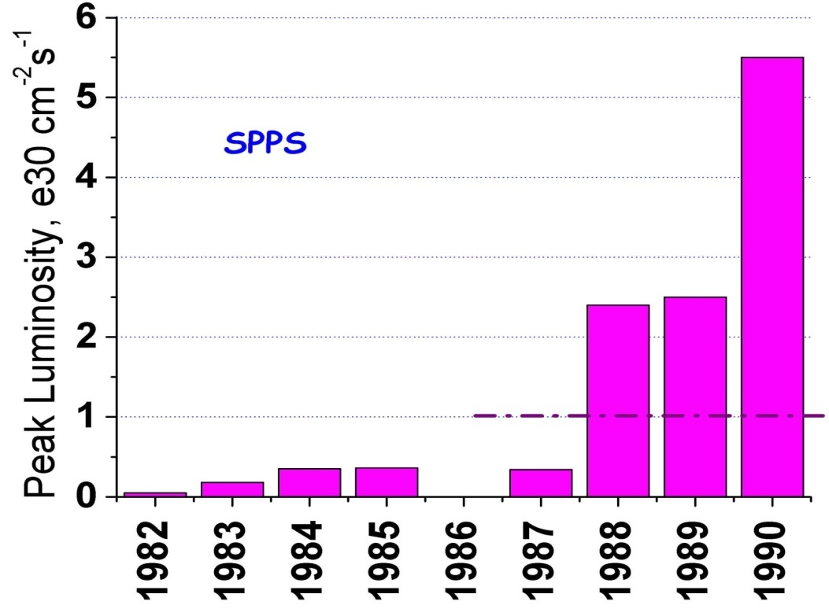
SppS: First proton-antiproton Collider
Protons from the SPS were used to produce antiprotons, which were collected
These were injected in the opposite direction and accelerated
First collisions in 1981
Discovery of @ and Z in 1983
Energy initially 270+270 GeV
Raised to 315+315 GeV
Peak luminosity: 5.5x10³⁰cm⁻²s⁻¹
~1% of current Tev/LHC
design

Slide 8
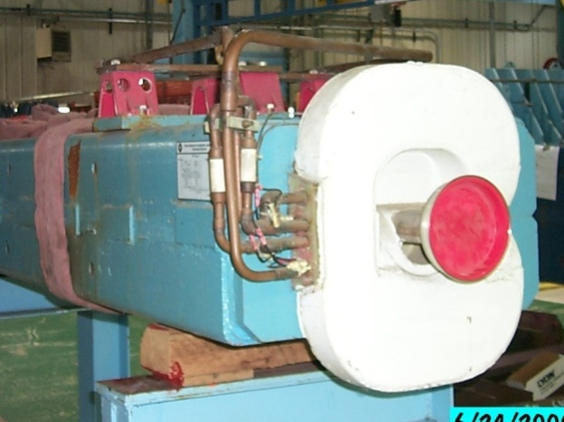
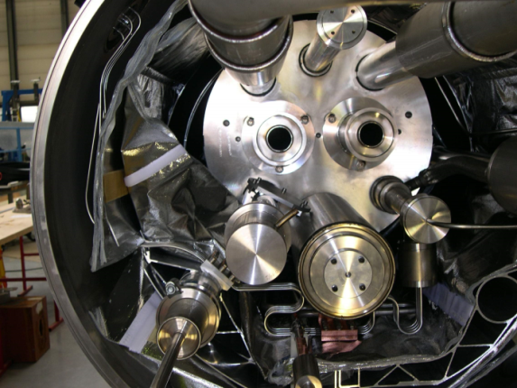
Superconductivity: Enabling Technology
The maximum SppS energy was limited by the maximum power loss that the conventional magnets could support in DC operation
P = I²R∝B²
Maximum practical DC field in conventional magnets ~1T
LHC made out of such magnets would be roughly the size of Rhode Island!
Highest energy colliders only possible using superconducting magnets
Must take the bad with the good
Conventional magnets are Superconducting magnets are simple and naturally dissipate complex and represent a great energy as they operate deal of stored energy which must be handled if something goes wrong

Slide 9
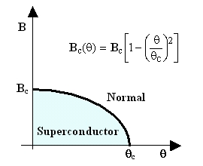
When is a superconductor not a superconductor?
Superconductor can change phase back to normal conductor by crossing the “critical surface”
When this happens, the conductor heats quickly, causing the surrounding conductor to go normal and dumping lots of heat into the liquid Helium
This is known as a “quench”, during which all of the energy stored in the magnet must be dissipated in some way
Dealing with this is the single biggest issue for any superconducting synchrotron!
Can push the B field (current) too high
Can increase the temp, through heat leaks, deposited energy or mechanical deformation
T_{c}

Slide 10
Milestones on the Road to a Superconducting Collider
1911 – superconductivity discovered by Heike Kamerlingh Onnes
1957 – superconductivity explained by Bardeen, Cooper, and Schrieffer
1972 Nobel Prize (the second for Bardeen!)
1962 – First commercially available superconducting wire
NbTi, the “industry standard” since
1978 – Construction began on ISABELLE, first superconducting collider (200 GeV+200 GeV) at Brookhaven.
1983, project cancelled due to design problems, budget overruns, and competition from…

Slide 11
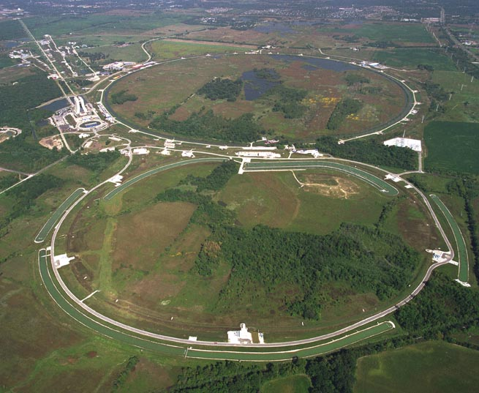
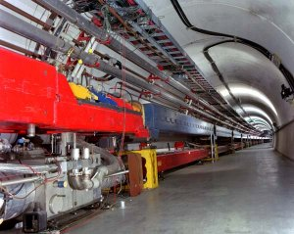
Tevatron: A brief history
1968 – Construction Begins
1972 – First 200 GeV beam in the Main Ring (400 GeV later that year)
Original director soon began to plan for a superconducting ring to share the tunnel with the Main Ring
1978 – First operation of Helium refridgerator
1982 – Magnet installation complete
Dubbed “Saver Doubler”
Installed underneath Main Ring
1983 – First (512 GeV) beam in the Tevatron (“Energy Doubler”). Old Main Ring serves as “injector”.
1985 – First proton-antiproton collisions observed at CDF (1.6 TeV CoM). Most powerful accelerator in the world for the next quarter century
Main Ring
Tevatron

Slide 12
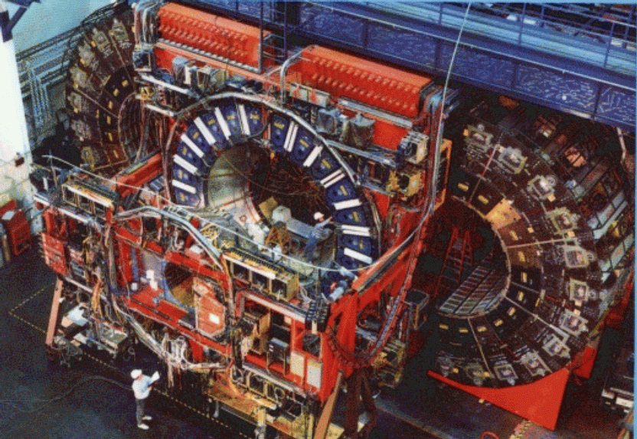
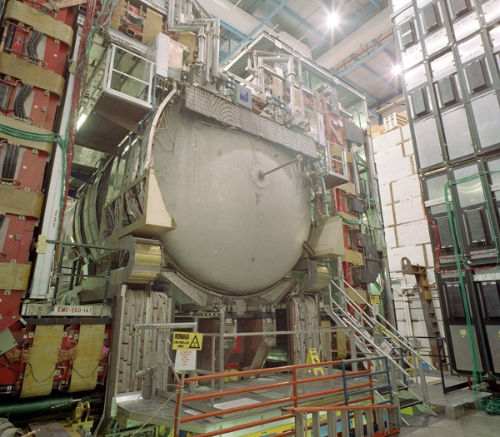
Experiments at the Tevatron
CDF (Collider Detector at Fermilab)
D0 (named for interaction point)
540 authors
15 countries
535 papers
500 PhD
550 authors
18 countries
(as of 2009)
>250 papers
>250 PhD students

Slide 13
Limits to Tevatron Luminosity
Tevatron luminosity has always been primarily limited by availability of antiprotons
In “stack and store” cycle, 120 GeV protons are used to produce antiprotons, which are collected in the Accumulator/Debuncher system.
After about a day, there are enough antiprotons to inject into the Tevatron, to be accelerated and put into collisions with protons in the other direction.
These collisions continue while more antiprotons are produced.
Initially, the production and antiprotons and intermediate acceleration were done with the original Main Ring, which still shared the tunnel with the Tevatron.
The biggest single upgrade has been the advent of the Main Injector, a separate accelerator to take over these tasks⇒”Run II”

Slide 14
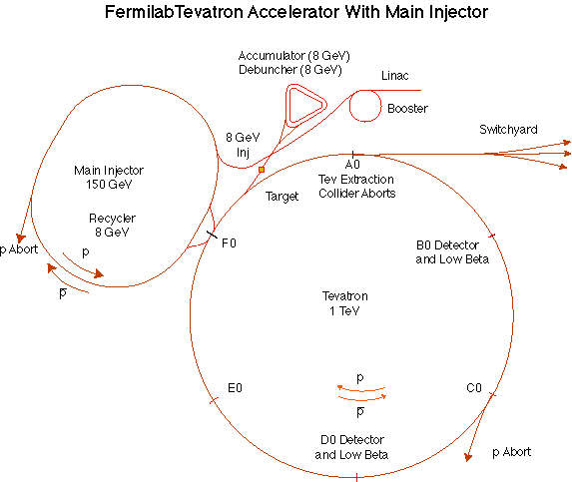
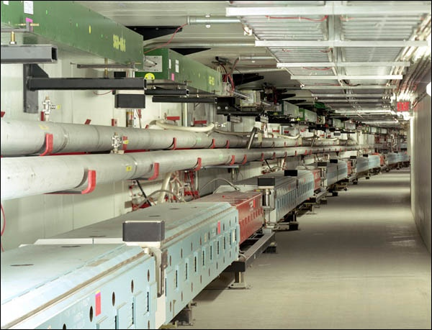
Run II: Main Injector/Recycler
The Main Injector
Replaced the Main Ring as the source of 120 GeV Protons for production of antiprotons
Accelerates protons and antiprotons to 150 GeV for injection into the Tevatron
Also serves 120 GeV neutrino and fixed target programs
The Recycler
8 GeV storage ring made of permanent magnets
Used to store large numbers of antiprotons from the Accumulator prior to injection into the Tevatron

Slide 15
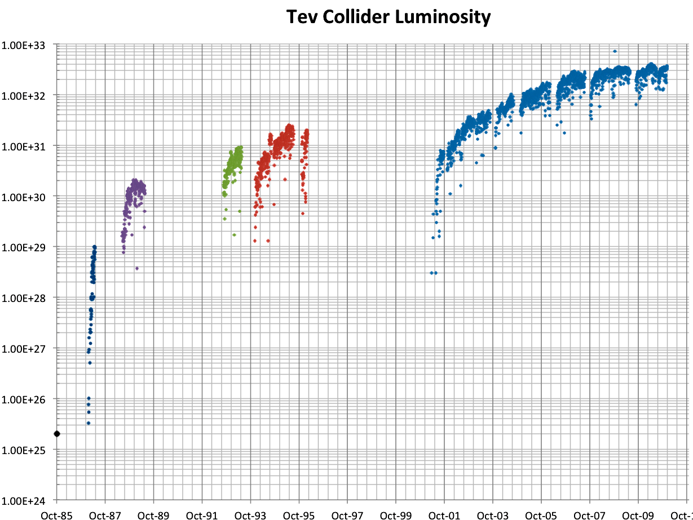
History of Fermilab Luminosity
ISR (pp) record
Original Run II Goal
SppS record
Run 1a
Run 1b
Run II
Run 0
Main Injector Construction
Discovery of top quark (1995)
87 Run

Slide 16
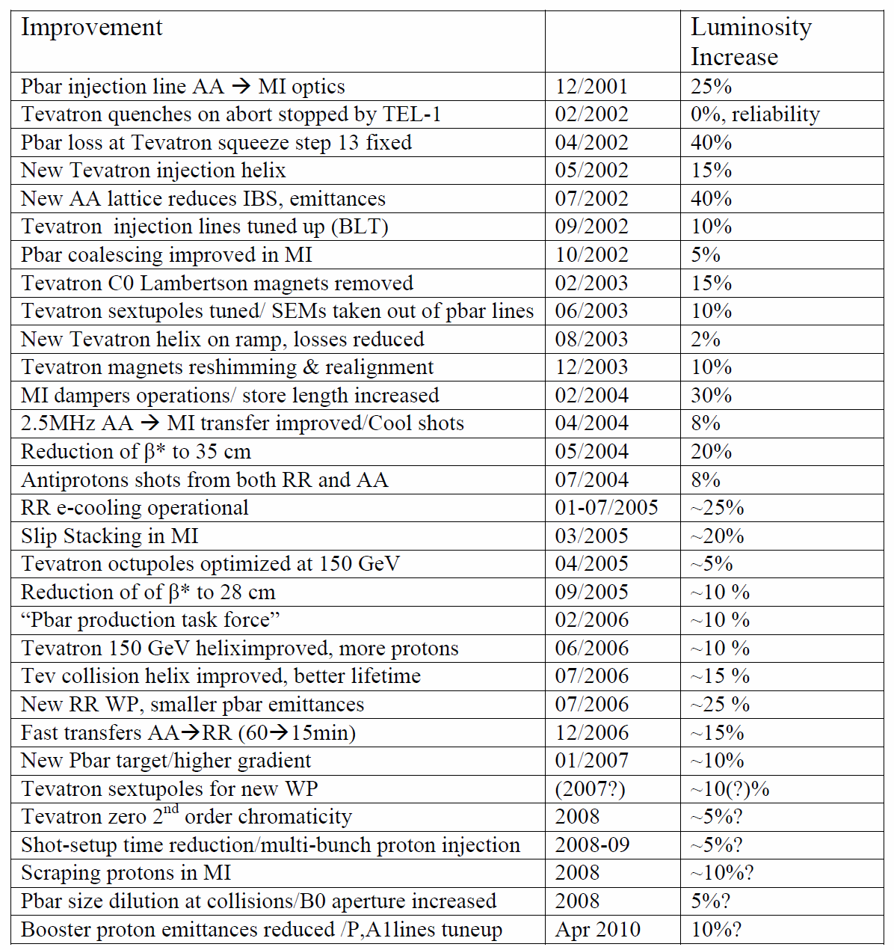
Run II: The road to peak luminosity
Some 30 steps, no “silver bullet”
Overall factor of 30 luminosity increase
16

Slide 17
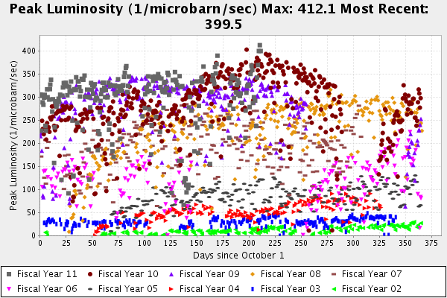
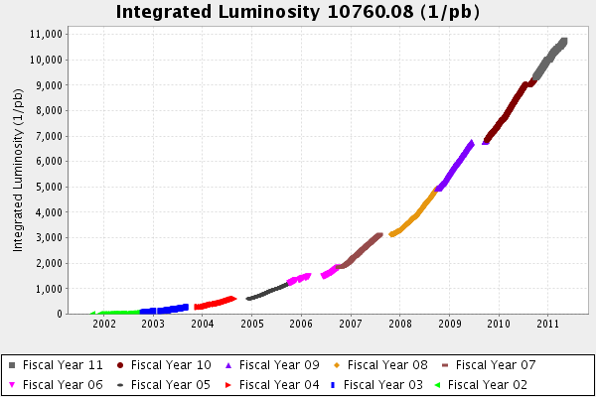
Tevatron End Game
The Tevatron has integrated over 10 fb⁻¹ per experiment
It has just set a new p-pbar luminosity record
4.05x10³² cm⁻²s⁻¹
However, as there are no plans to increase the peak luminosity, the doubling time would be 3-5 years
With the advent of the LHC, the Tevatron is slated to turn off at the end of September, 2011

Slide 18
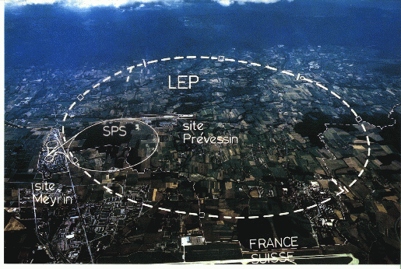
LHC: Location, Location, Location…
My House (1990-1992)
/LHC
Tunnel originally dug for LEP
Built in 1980’s as an electron positron collider
Max 100 GeV/beam, but 27 km in circumference!!

Slide 19
Partial LHC Timeline
1994:
The CERN Council formally approves the LHC
1995:
LHC Technical Design Report
2000:
LEP completes its final run
First dipole delivered
2005
Civil engineering complete (CMS cavern)
First dipole lowered into tunnel
2007
Last magnet delivered
First sector cold
All interconnections completed
2008
Accelerator complete
Last public access
Ring cold and under vacuum

Slide 20
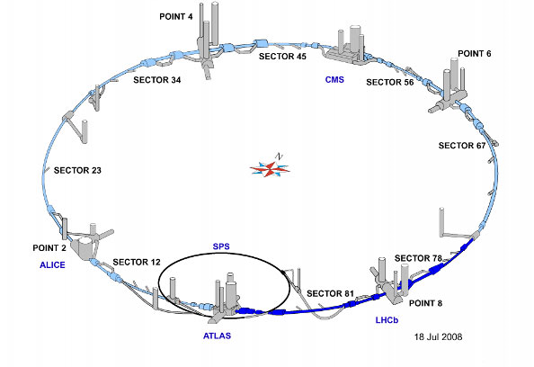
LHC Layout
8 crossing interaction points (IP’s)
Accelerator sectors labeled by which points they go between
ie, sector 3-4 goes from point 3 to point 4

Slide 21
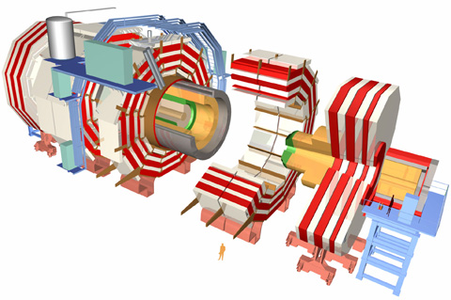
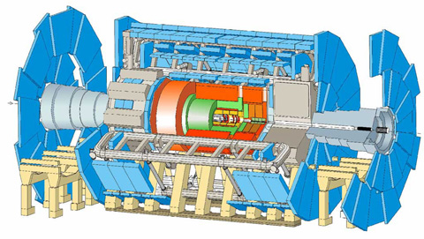
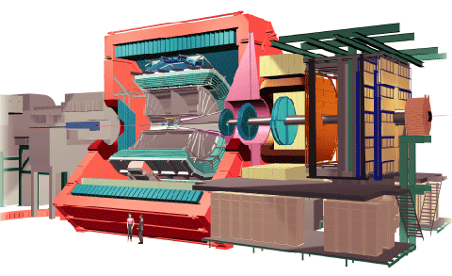
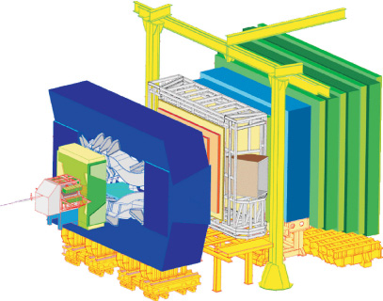
LHC Experiments
Huge, general purpose experiments:
“Medium” special purpose experiments:
Compact Muon Solenoid (CMS)
A Toroidal LHC ApparatuS (ATLAS)
A Large Ion Collider Experiment (ALICE)
B physics at the LHC (LHCb)

Slide 22
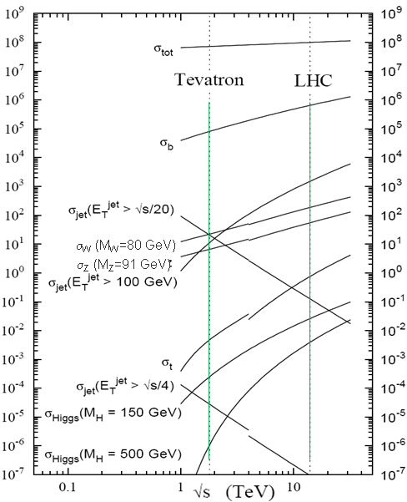
Nominal LHC Parameters Compared to Tevatron
Parameter | Tevatron | “nominal” LHC
Circumference | 6.28 km (2*PI) | 27 km
Beam Energy | 980 GeV | 7 TeV
Number of bunches | 36 | 2808
Protons/bunch | 275x10⁹ | 115x10⁹
pBar/bunch | 80x10⁹ | -
Stored beam energy | 1.6 + .5 MJ | 366+366 MJ*
Peak luminosity | 3.3x10³² cm⁻²s⁻¹ | 1.0x10³⁴ cm⁻²s⁻¹
Main Dipoles | 780 | 1232
Bend Field | 4.2 T | 8.3 T
Main Quadrupoles | ~200 | ~600
Operating temperature | 4.2 K (liquid He) | 1.9K (superfluid He)
Increase in cross section of up to 5 orders of magnitude for some physics processes
1.0x10³⁴ cm⁻²s⁻¹ ~ 50 fb⁻¹/yr
*2.1 MJ ≡ “stick of dynamite” ⇒ very scary numbers

Slide 23
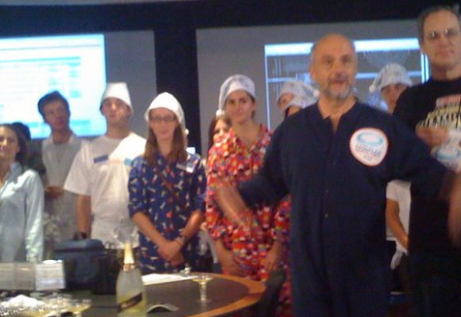
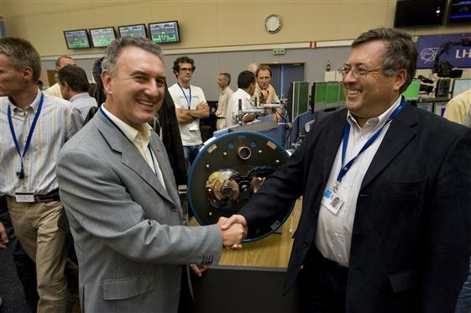
Initial Startup and “Incident”
Note: because of a known problem with magnet de-training, initial operation was always limited to 5 TeV/beam
On September 10, 2008 a worldwide media event was planned for the of the LHC
9:35 CET: First beam injected
10:26 CET: First full turn (<1 hour)
Commissioning was proceeding very smoothly, until…
September 19th, sector 3-4 was being ramped (without beam) to the equivalent of 5.5 TeV for the first time
All other sectors had been commissioned to this field prior to start up
A quench developed in a superconducting interconnect
The resulting arc burned through the beam pipe and Helium transport lines, causing Helium to boil and rupture into the insulation vacuum

Slide 24
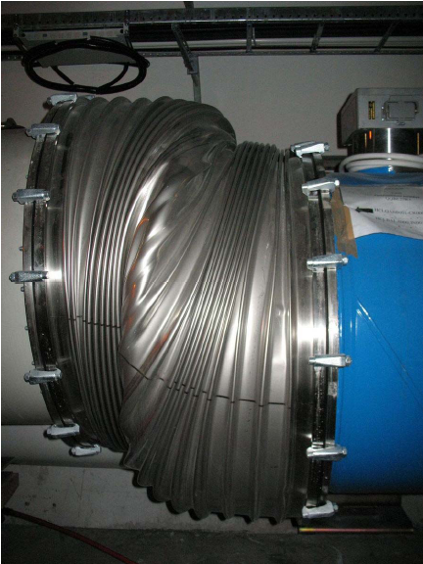
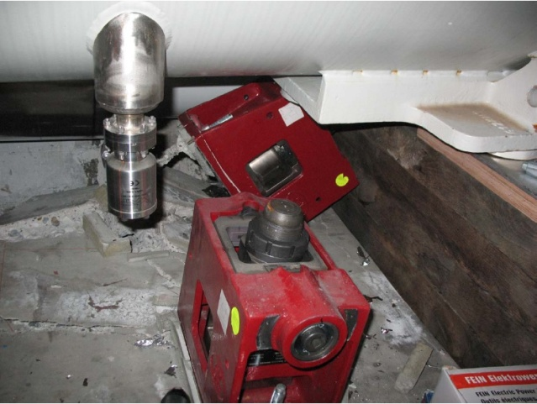
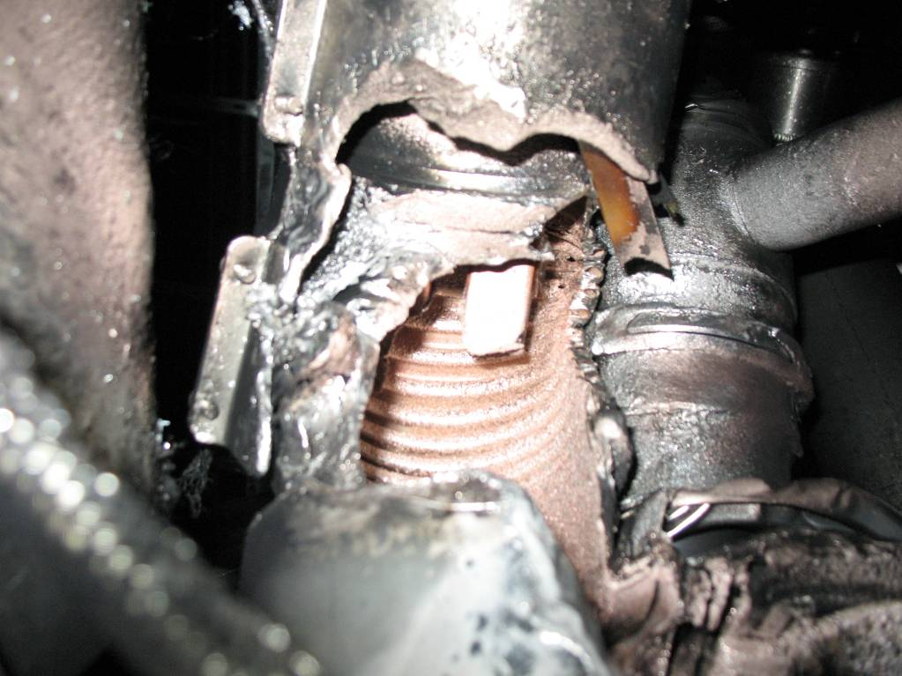
Collateral Damage From Incident
At the subsector boundary, pressure was transferred to the cold mass and magnet stands

Slide 25
Improvements
Bad joints
Test for high resistance and look for signatures of heat loss in joints
Warm up to repair any with signs of problems (additional three sectors)
Quench protection
Old system sensitive to 1V
New system sensitive to .3 mV (factor >3000)
Pressure relief
Warm sectors (4 out of 8)
Install 200mm relief flanges
Enough capacity to handle even the maximum credible incident (MCI)
Cold sectors
Reconfigure service flanges as relief flanges
Reinforce floor mounts
Enough capacity to handle the incident that occurred, but not quite the MCI
Beam re-started on November 20, 2009
Still limited to 3.5 TeV/beam until joints fully repaired/rebuilt

Slide 26
Limits to LHC Luminosity*
Rearranging standard terms a bit…
Total beam current. Limited by:
Uncontrolled beam loss!
E-cloud and other instabilities
Brightness, limited by
Injector chain
Max. beam-beam
If n_{b}>156, must turn on crossing angle…
β at IP, limited by
magnet technology
chromatic effects
…which reduces this
*see, eg, F. Zimmermann, “CERN Upgrade Plans”, EPS-HEP 09, Krakow

Slide 27
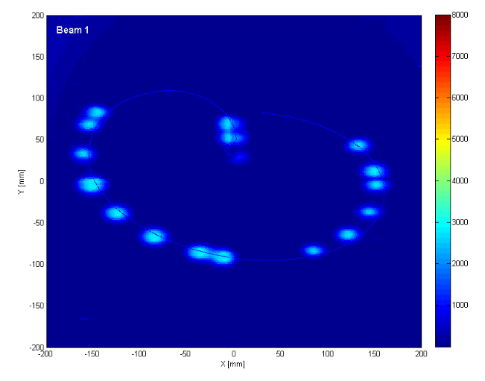
General Plan
Push bunch intensity
Already reached nominal bunch intensity of >1.1x10¹¹ much faster than anticipated.
Remember: L∝N_{b}²
Rules out many potential accelerator problems
Increase number of bunches
Go from single bunches to “bunch trains”, with gradually reduced spacing.
At all points, must carefully verify
Beam collimation
Beam protection
Beam abort
Remember:
TeV=1 week for cold repair
LHC=3 months for cold repair
Example: beam sweeping over abort

Slide 28
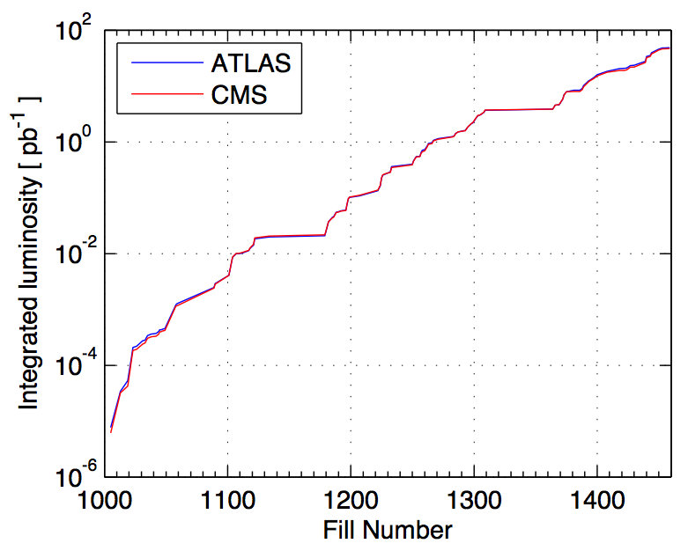
2010 Performance*
Performance ramp-up (368 bunches)
Nominal bunch operation (up to 48)
Bunch trains
Initial luminosity run
Nominal bunch commissioning
*From presentation by DG to CERN staff

Slide 29
Significant Milestones
Sunday, November 29th, 2009:
Both beams accelerated to 1.18 TeV simultaneously
LHC Highest Energy Accelerator
Monday, December 14th
Stable 2x2 at 1.18 TeV
Collisions in all four experiments
LHC Highest Energy Collider
Tuesday, March 30th, 2010
Collisions at 3.5+3.5 TeV
LHC Reaches target energy for 2010-2012
Friday, April 22nd, 2011
Luminosity reaches 4.67x10³² cm⁻²s⁻¹
LHC Highest luminosity hadron collider in the world

Slide 30
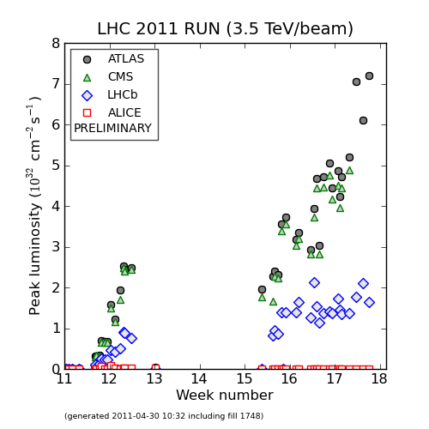
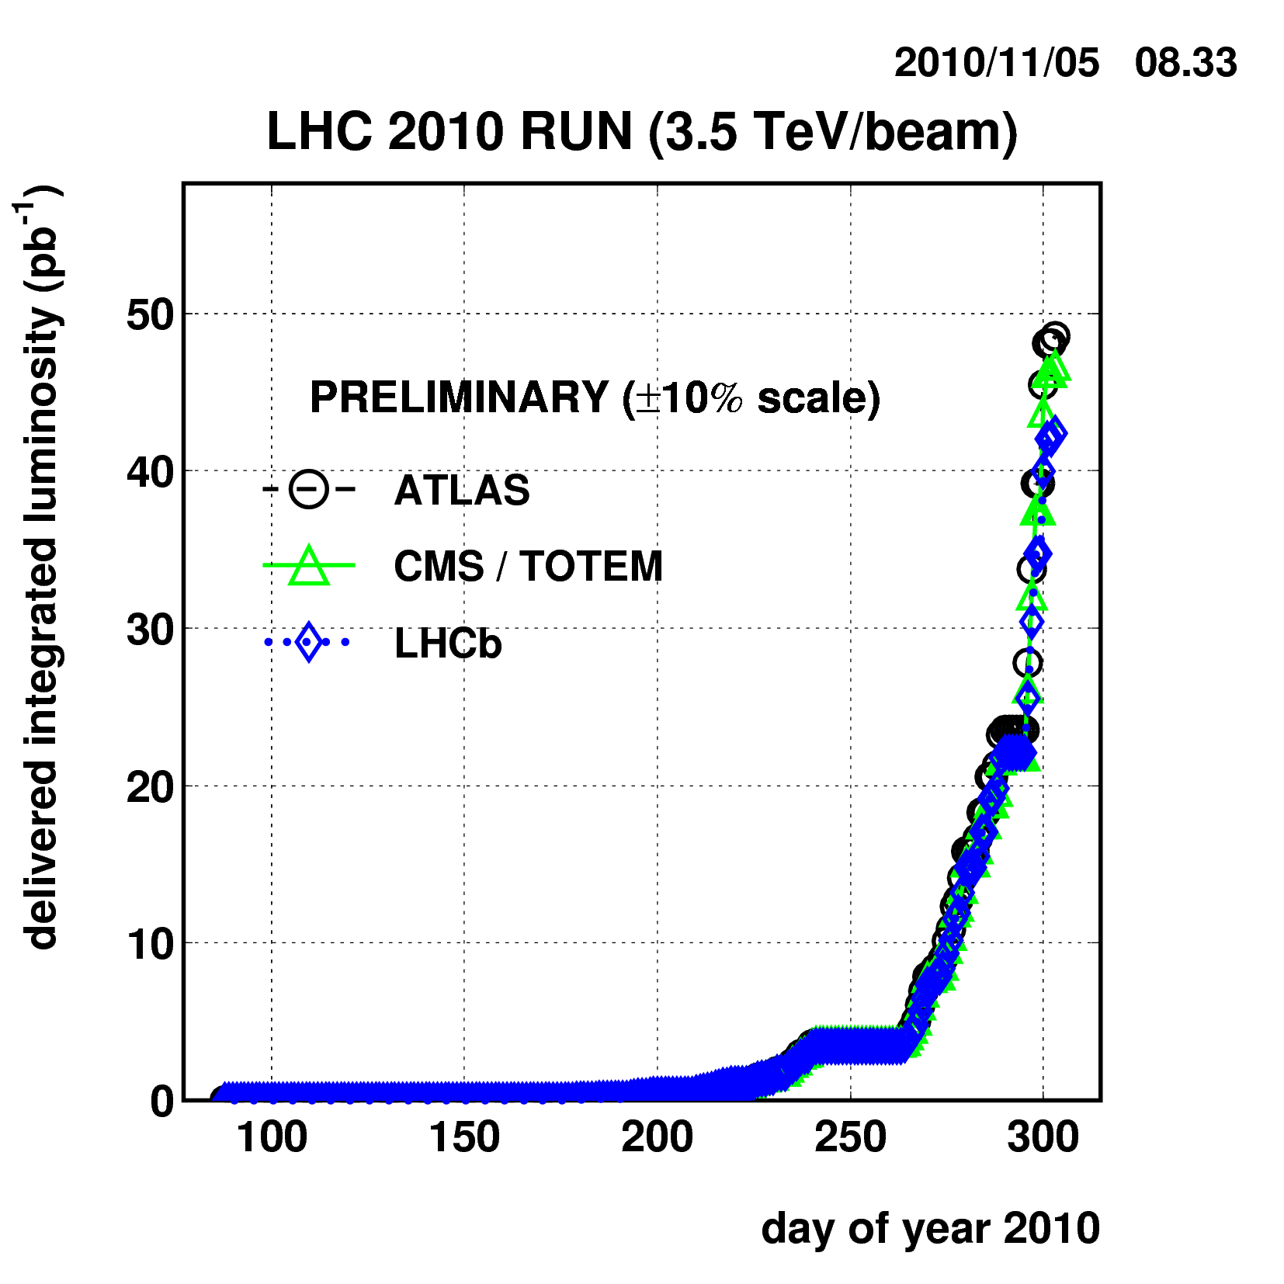
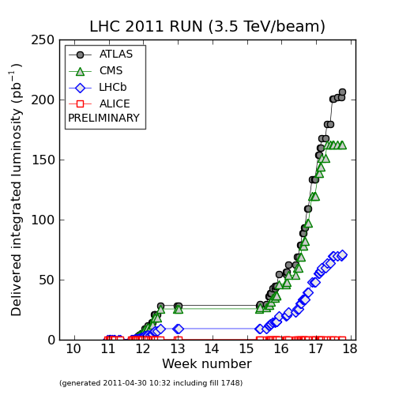
“Current Status” (already out of date)
Tevatron Record
Peak Luminosity:
~7x10³² cm⁻²s⁻¹ (7% of nominal)
Integrated Luminosity:
~250 pb⁻¹/experiment

Slide 31
Near Term Plan*
Continue to increase number of bunches to increase luminosity
Base line still 1fb⁻¹ for 2011
Hope for 3-5 fb⁻¹
Energy will remain at 3.5 TeV/beam for 2011
Too big a risk to increase it now
Some possibility to increase it to 4 or 4.5 TeV/beam 2012
Shut down for ~15 months starting in 2013 to fully repair joints and improve collimation
Run towards nominal luminosity (10³⁴ cm⁻²s⁻¹)

Slide 32
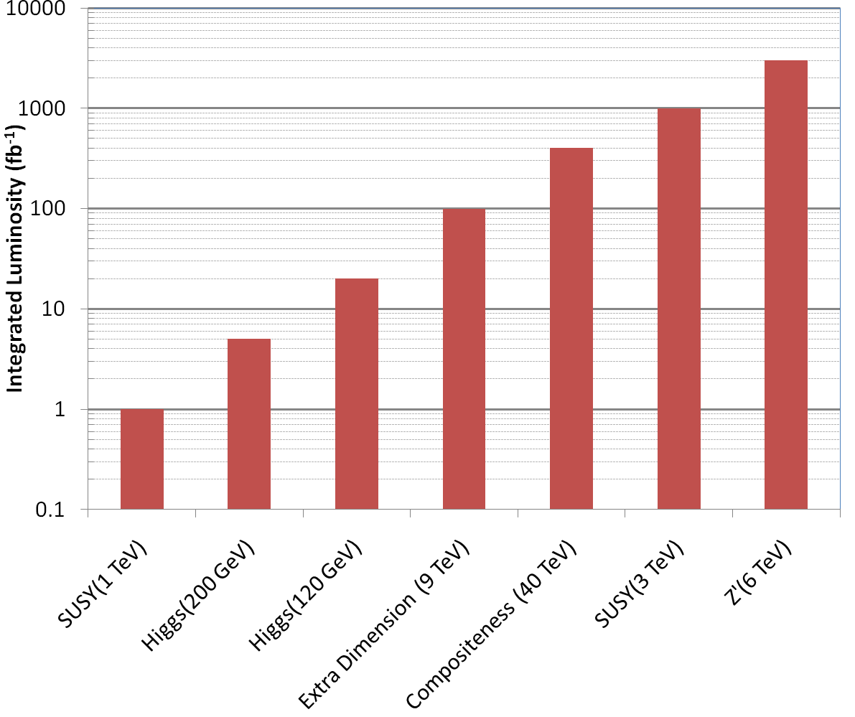
Nice Work, but…
3000 fb⁻¹
~700 years at present luminosity
~50 years at design luminosity
The future begins now

Slide 33
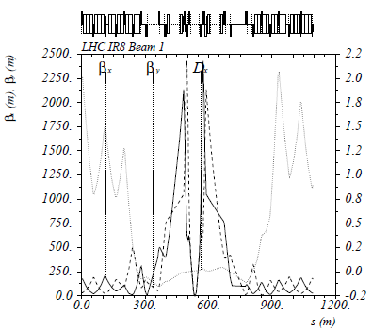
The Case for New Quadupoles
HL-LHC Proposal: β*=55 cm ⇒ β*=10 cm
Just like classical optics
Small, intense focus ⇒ big, powerful lens
Small β*⇒huge β at focusing quad
Need bigger quads to go to smaller β*
Existing quads
70 mm aperture
200 T/m gradient
Proposed for upgrade
At least 120 mm aperture
200 T/m gradient
Field 70% higher at pole face
Beyond the limit of NbTi
Must go to Nb₃Sn (LARP)

Slide 34
After 2013
Increase energy to 7 TeV/beam (or close to it)
Increase luminosity to nominal 1x10³⁴ cm⁻²s⁻¹
Run!
Shut down in ~2017
Tie in new LINAC
Increase Booster energy 1.4->2.0 GeV
Finalize collimation system (LHC collimation is a talk in itself)
Shut down in ~2021
Full luminosity: >5x10³⁴ leveled
New inner triplets based on Nb₃Sn
Smaller β means must compensate for crossing angle
Crab cavities base line option
Other solutions considered as backup
If everything goes well, could reach 3000 fb⁻¹ by 2030

Slide 35
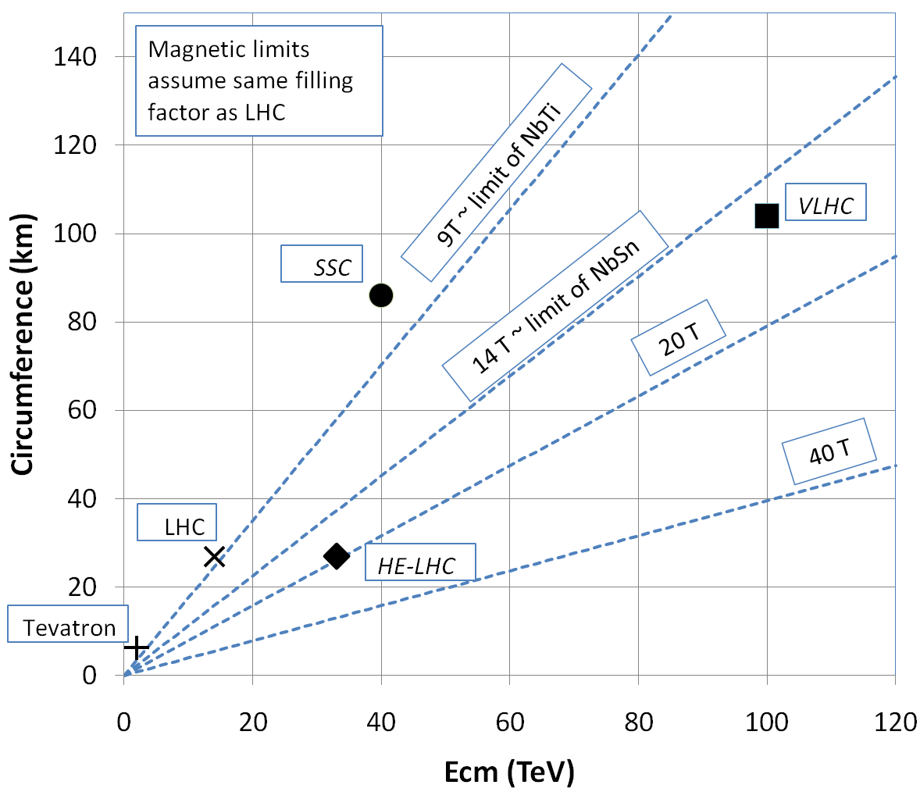
What next?
In October 2010, a workshop was organized to discuss the potential to build a higher energy synchrotron in the existing LHC tunnel.
Nominal specification
Energy: 16.5+16.5 TeV
Luminosity: at least 2x10³⁴ cm⁻²s⁻¹
Construction to begin: ~2030
This is beyond the limit of NbTi magnets
Must utilize alternative superconductors
Likely a hybrid design to reduce cost

Slide 36
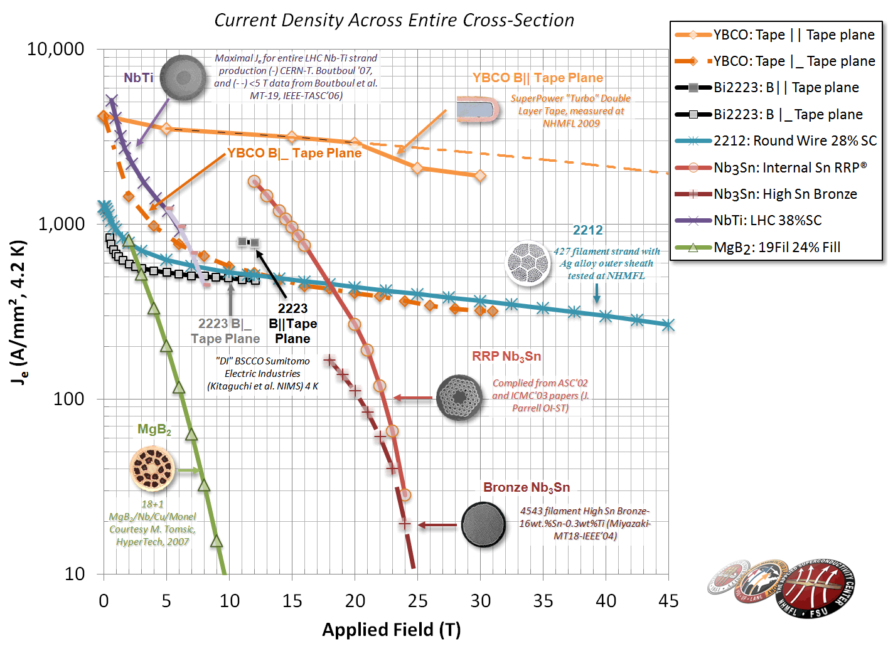
Alternative Superconductors*
NbTi=basis of ALL SC accelerators magnets to date
The future?
J_{e} floor for practicality
Nb₃Sn=next generation
*Peter Lee (FSU)

Slide 37
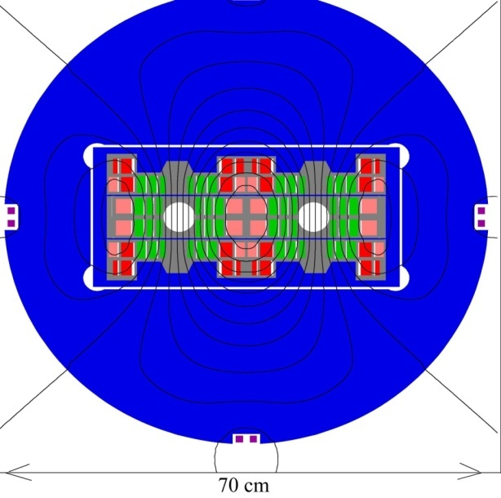
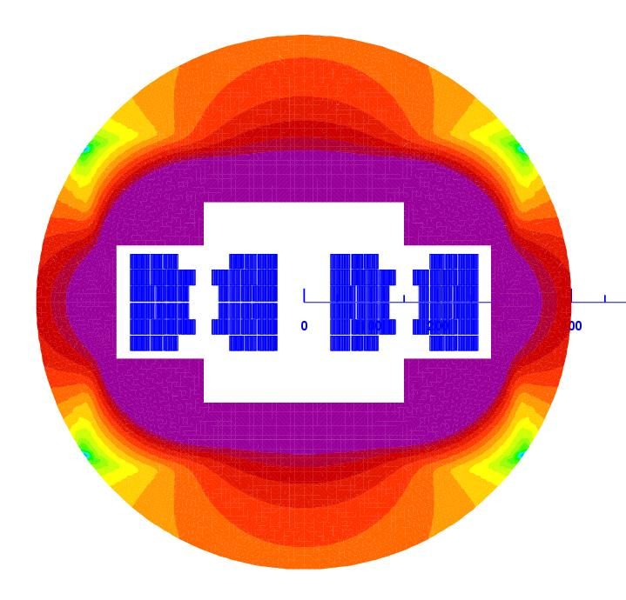
Potential Designs
P. McIntyre 2005 – 24T ss Tripler, a lot of Bi-2212 , Je = 800 A/mm2
E. Todesco 2010
20 T, 80% ss
30% NbTi
55 %NbSn
15 %HTS
All Je < 400 A/mm2

Slide 38
Summary and Conclusion
The quest for the highest energy has driven accelerator science since the very beginning.
After an unprecedented quarter century reign, the Tevatron has been superceded by LHC as the world’s energy frontier machine.
The startup of the LHC has been remarkably smooth
for the most part!
It will likely be the worlds premiere discovery machine for some time to come.
Nevertheless, given the complexity of the next steps
Luminosity
Energy
there’s no time to rest
The future starts now!!

Slide 39
Acknowlegments
Since this is a summary talk, it would be impossible to list all of the people who have contributed to it.
Let’s just say at least everyone at CERN and Fermilab, past and present…
…and some other people, too.

Slide 40
BACKUP SLIDES

Slide 41
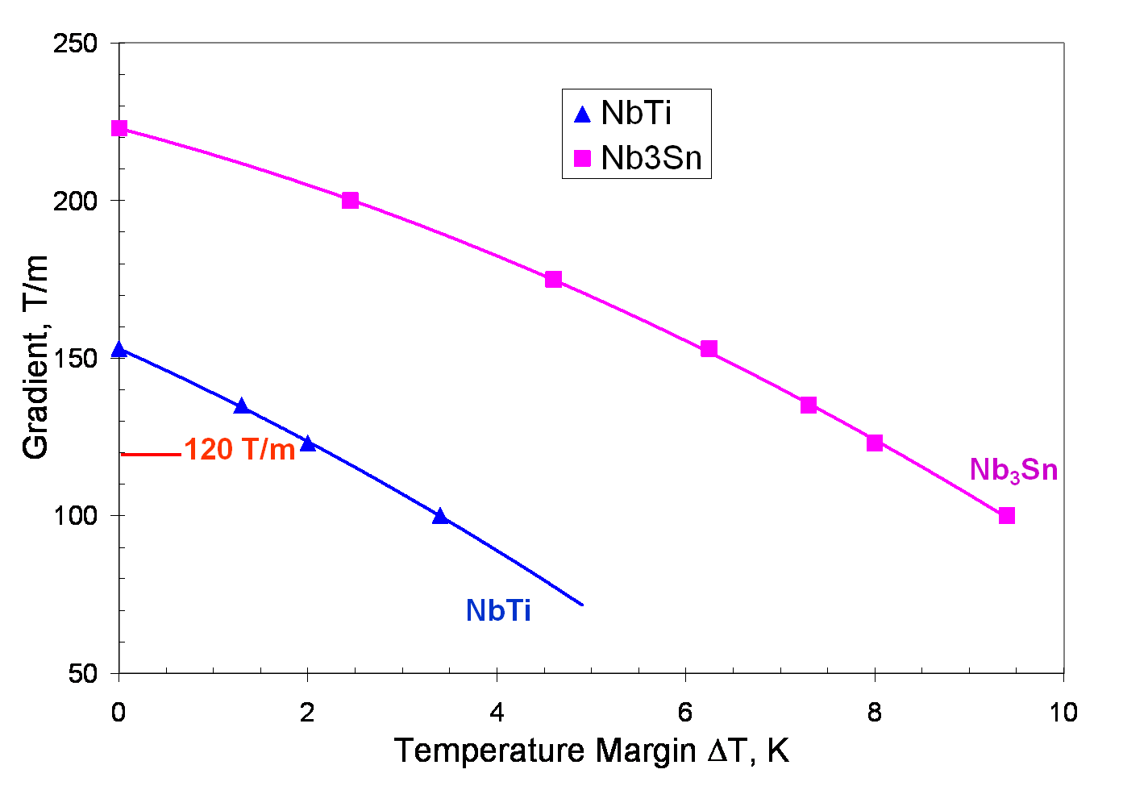
Motivation for Nb₃Sn
Nb₃Sn can be used to increase aperture/gradient and/or increase heat load margin, relative to NbTi
Limit of NbTi magnets
Very attractive, but no one has ever built accelerator quality magnets out of Nb₃Sn
Whereas NbTi remains pliable in its superconducting state, Nb3Sn must be reacted at high temperature, causing it to become brittle
Must wind coil on a mandrel
React
Carefully transfer to magnet
120 mm aperture

Slide 42
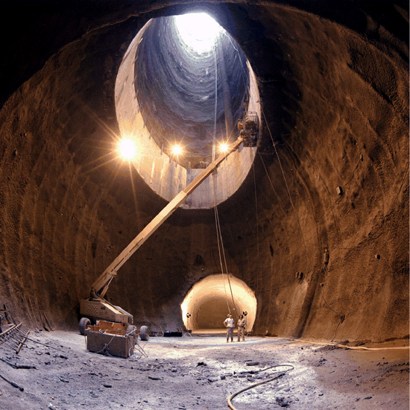
The (side) Road to Higher Energy
1980’s - US begins planning in earnest for a 20 TeV+20 TeV “Superconducting Super Collider” or (SSC).
87 km in circumference!
Considered superior to the “Large Hadron Collider” (LHC) then being proposed by CERN.
1987 – site chosen near Dallas, TX
1989 – construction begins
1993 – amidst cost overruns and the end of the Cold War, the SSC is canceled after 17 shafts and 22.5 km of tunnel had been dug.

Slide 43
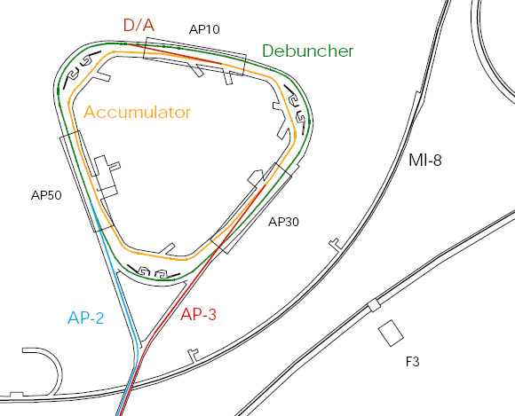
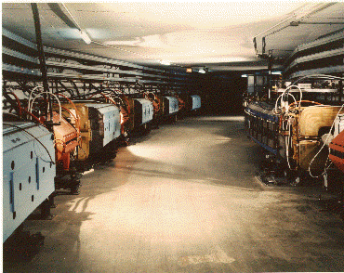
Operation of Debuncher/Accumulator
Protons are accelerated to 120 GeV in Main Injector and extracted to pBar target
pBars are collected and phase rotated in the “Debuncher”
Transferred to the “Accumulator”, where they are cooled and stacked

Slide 44
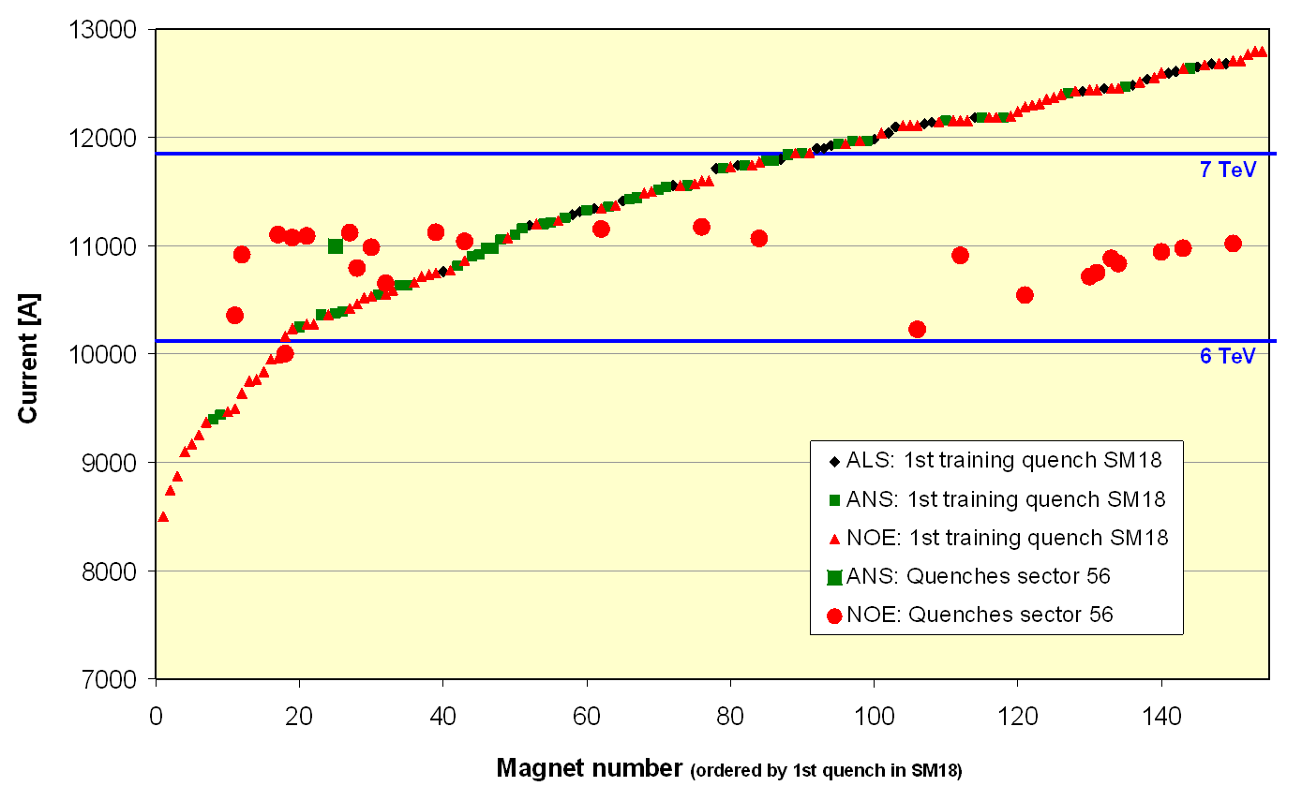
Problems out of the Gate
Magnet de-training
ALL magnets were “trained” to achieve 7+ TeV.
After being installed in the tunnel, it was discovered that the magnets supplied by one of the three vendors “forgot” their training.
Symmetric Quenches
The original LHC quench protection system was insensitive to quenches that affected both apertures simultaneously.
While this seldom happens in a primary quench, it turns out to be common when a quench propagates from one magnet to the next.
1st Training quench above ground
1st quench in tunnel
For these reasons, the initial energy target was reduced to 5+5 TeV well before the start of the 2008 run.

Slide 45
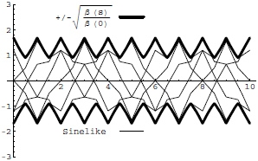
Digression: All the Beam Physics U Need 2 Know
Transverse beam size is given by
Betatron function: envelope determined by optics of machine
Trajectories over multiple turns
Note: emittance shrinks with increasing beam energy ⇒”normalized emittance”
Emittance: area of the ensemble of particle in phase space
Area = ε
Usual relativistic β & γ

Slide 46
Collider Luminosity
For identical, Gaussian colliding beams, luminosity is given by
Revolution frequency
Number of bunches
Bunch size
Betatron function at collision point
Transverse beam size
Normalized beam emittance
Geometric factor, related to crossing angle.

Slide 47
Limits to LHC Luminosity*
Rearranging terms a bit…
Total beam current. Limited by:
Uncontrolled beam loss!
E-cloud and other instabilities
Brightness, limited by
Injector chain
Max. beam-beam
If n_{b}>156, must turn on crossing angle…
β at IP, limited by
magnet technology
chromatic effects
…which reduces this
*see, eg, F. Zimmermann, “CERN Upgrade Plans”, EPS-HEP 09, Krakow

Slide 48
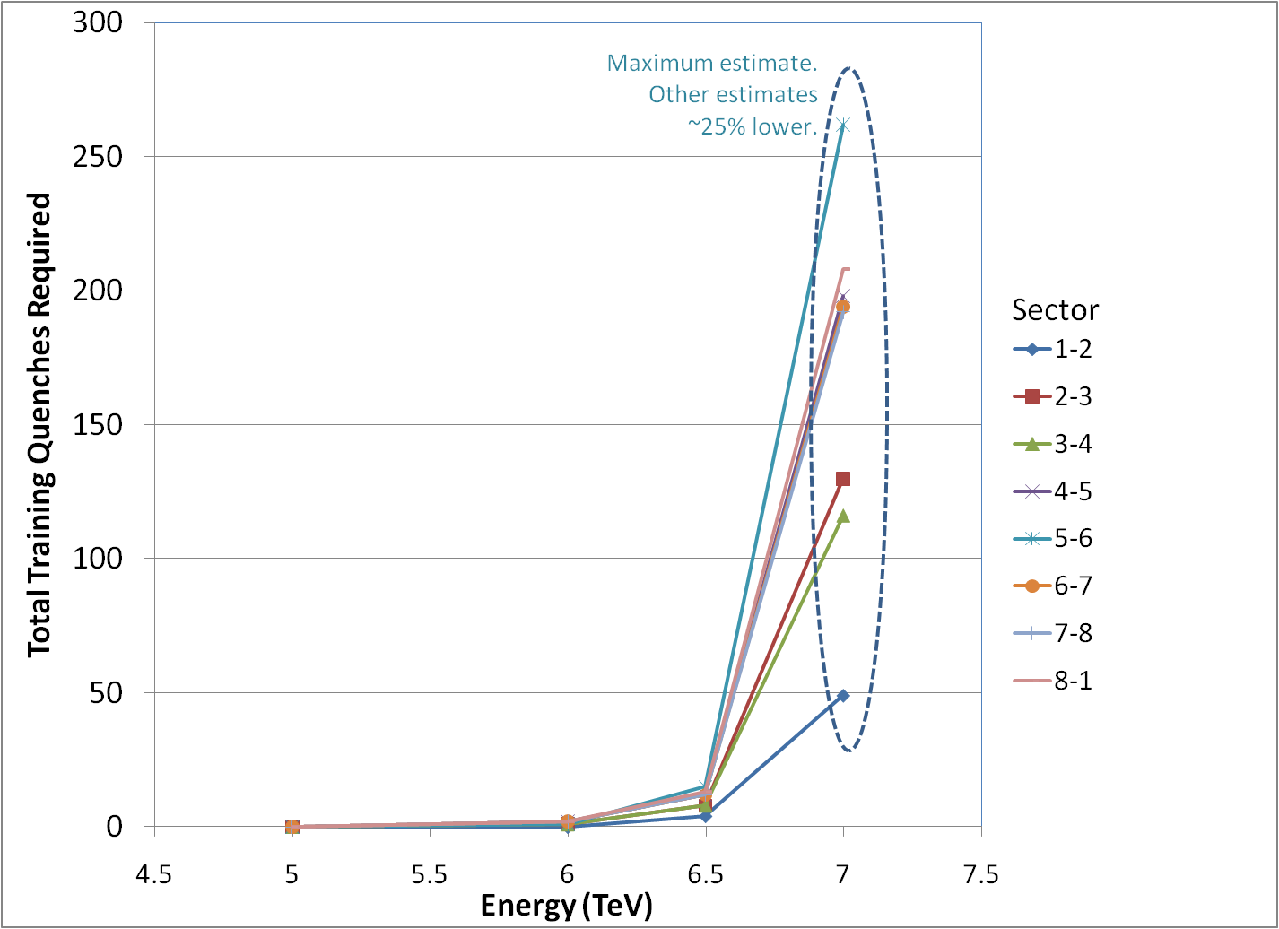
Getting to 7 TeV*
Note, at high field, max 2-3 quenches/day/sector
Sectors can be done in parallel/day/sector (can be done in parallel)
No decision yet, but it will be a while
*my summary of data from A. Verveij, talk at Chamonix, Jan. 2009

